Slide 1


Minotaur Maze Game
San Tran
Victoria Tran
Justin Castillo
Kailie Chang

Slide 2
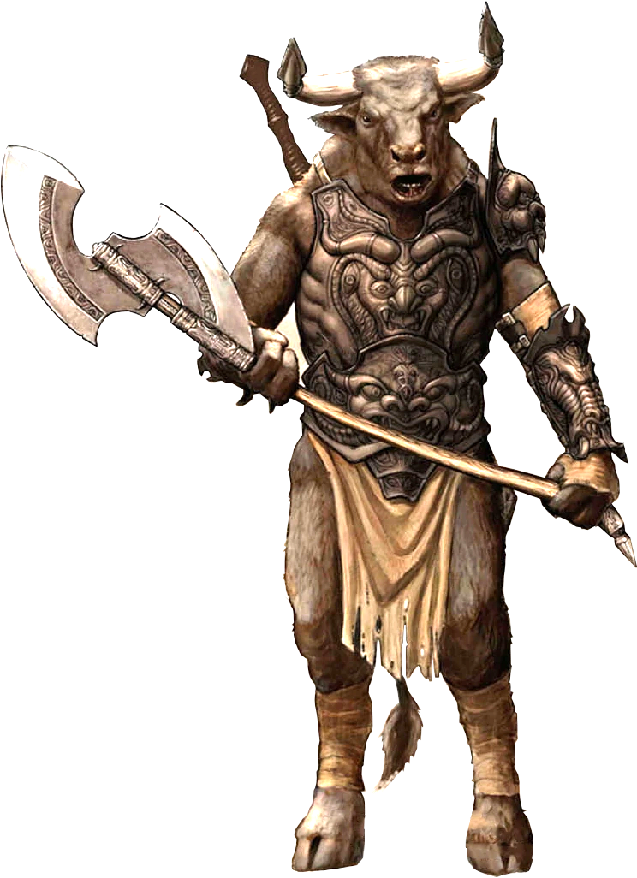
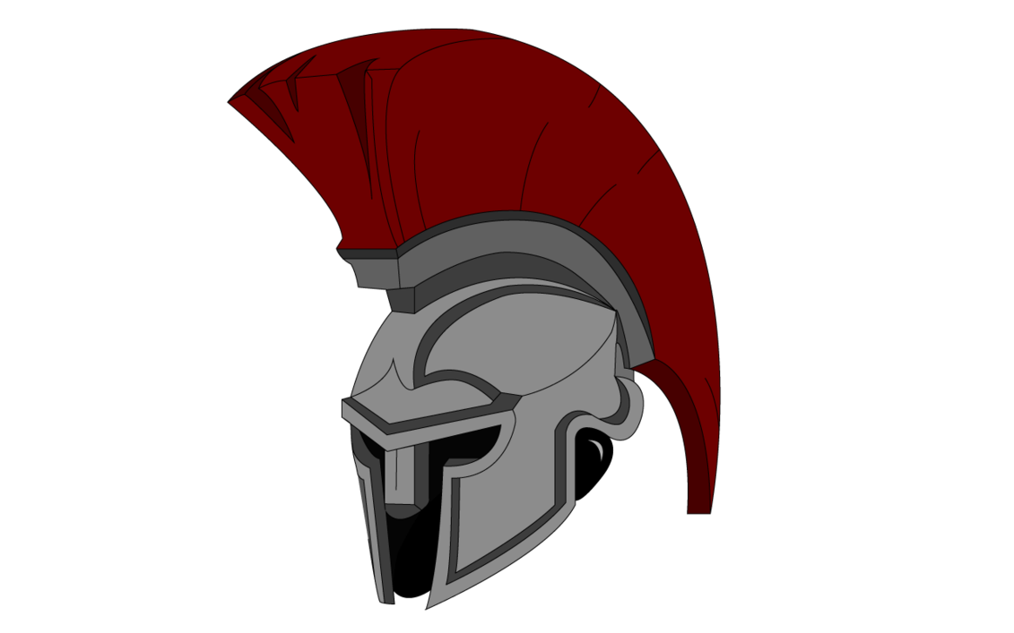

Game Concept
Greek mythology describes a Minotaur as a mythical monster that is half human and half bull. In the mythology, this creature hunts for a Greek hero through a maze. Thus, our team will attempt to recreate this mythology through a mini maze game in which the Minotaur will hunt the Greek hero.

Slide 3
How the game works
A maze/dungeon is randomly generated at the start of the program and displays two characters at their initial positions: the player and the minotaur
The player is controlled by using the arrow keys implemented by key listeners and checking if the cells that it wants to move to are available
The minotaur is implemented by using search algorithms to allow it to wander around the maze/dungeon and find the player
The goal of this game is to find the path to the key and open the door to the end of the maze/dungeon without getting caught by the minotaur

Slide 4
How difficulty is measured/changed
Minotaur’s Behavior
Every once and awhile it “sniffs” out the players location. Then during set intervals it will travel to it.
Difficulty is changed by updating the target path more often and increasing the minotaurs running speed
Spawn multiple minotaurs

Slide 5
What Algorithms we used
Depth First Search
Used to generate the initial maze
The maze is generated using DFS; randomly choosing paths in the grid before
Best First Search
The AI uses best first search to find the path to the player.
The heuristic we used was the distance from AI to the player as our heuristic score.
When choosing potential branches to search we prioritize paths the get ‘relatively’ closer to the player.

Slide 6
Demo
Here we can post a screenshot of the maze then have multiple transitions to show what we talked about in this powerpoint
Initial Maze Generation
DFS with the initial Maze
Who want to play video games to finish off out presentation.

